Slide 1
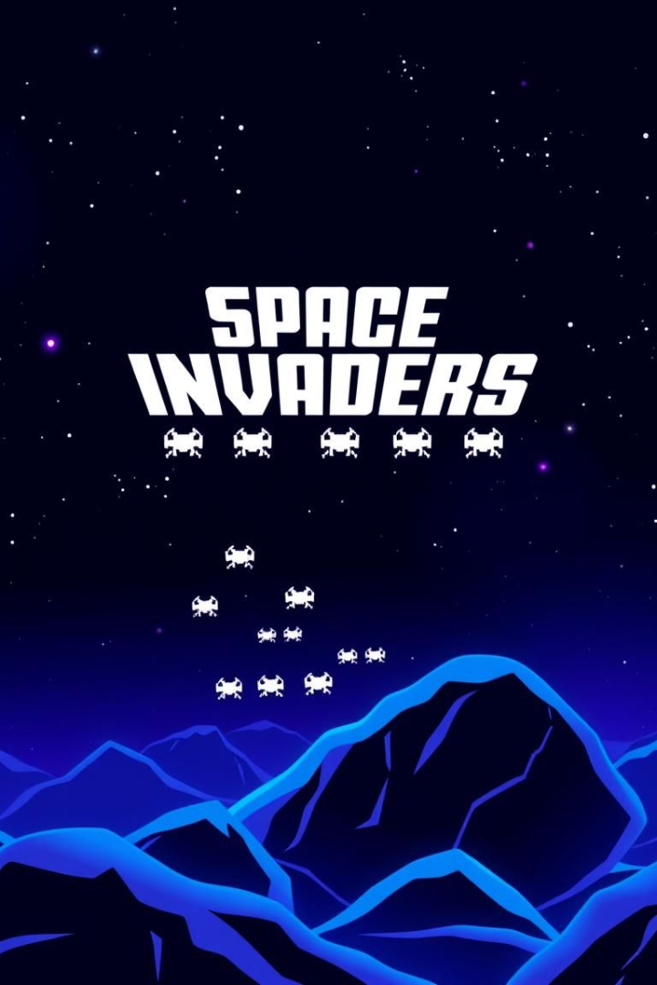
Space Invaders: A Multi-Agent Showdown
-Presented by
ADHIRAJ GHOSAL(22053132)
RAJESHWARI CHOUDHURY(22053180)
This project reimagines Space Invaders, introducing both AI and Human agents. The objective is to compare the performance of Human vs. AI players across three gaming modes. Expected outcomes include insights into AI learning strategies, human gameplay tactics, and the future of human-AI collaboration in gaming.

Slide 2
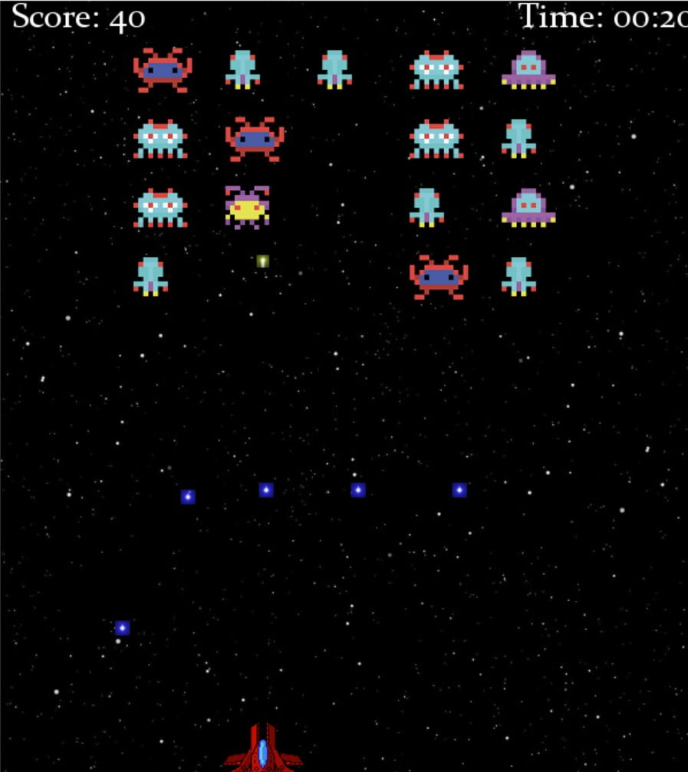
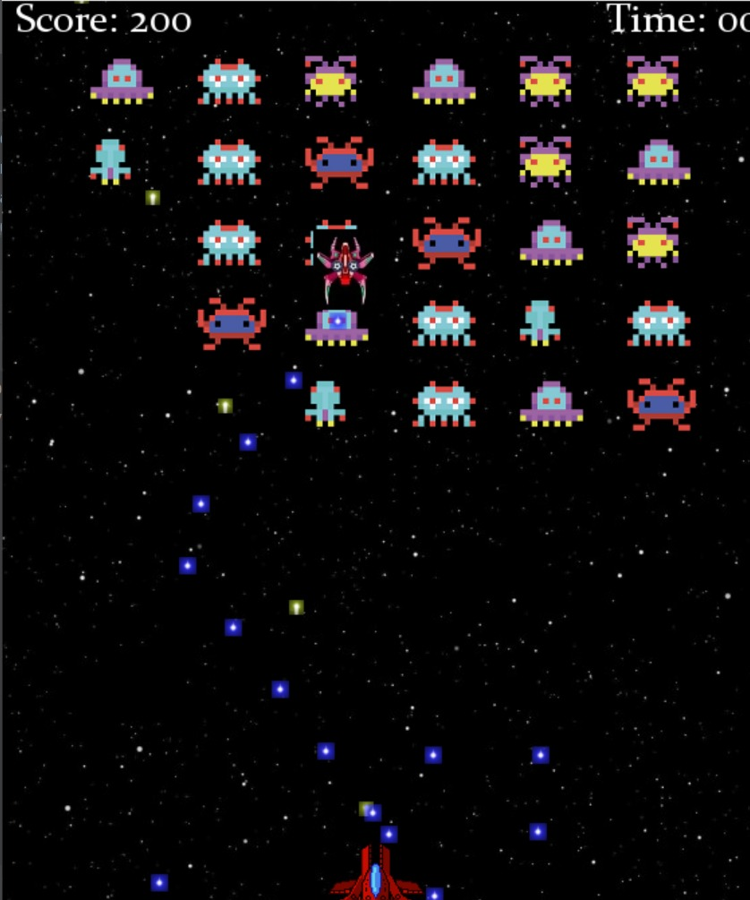
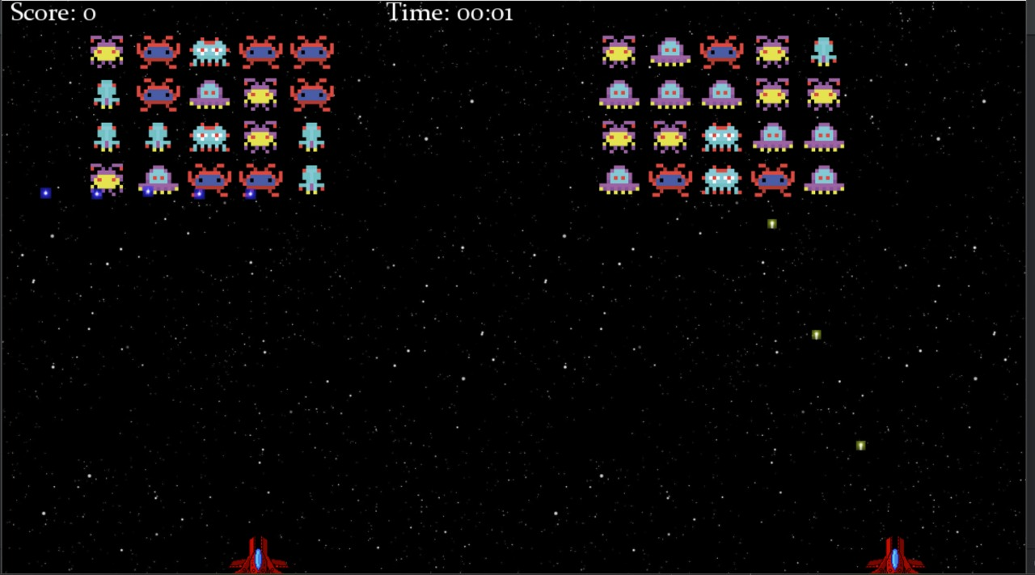
Introducing the Three Gaming Modes
Each mode is designed to evaluate different aspects of agent performance.
Mode 1: Human vs. AI
Mode 2: AI vs. AI
Mode 3: Human + AI vs. AI + AI
Classic 1v1 battle analyzing human strategies against a learning AI.
AI evolution simulation observing learning patterns and competitive dynamics.
Evaluate human-AI teams against purely AI teams.

Slide 3
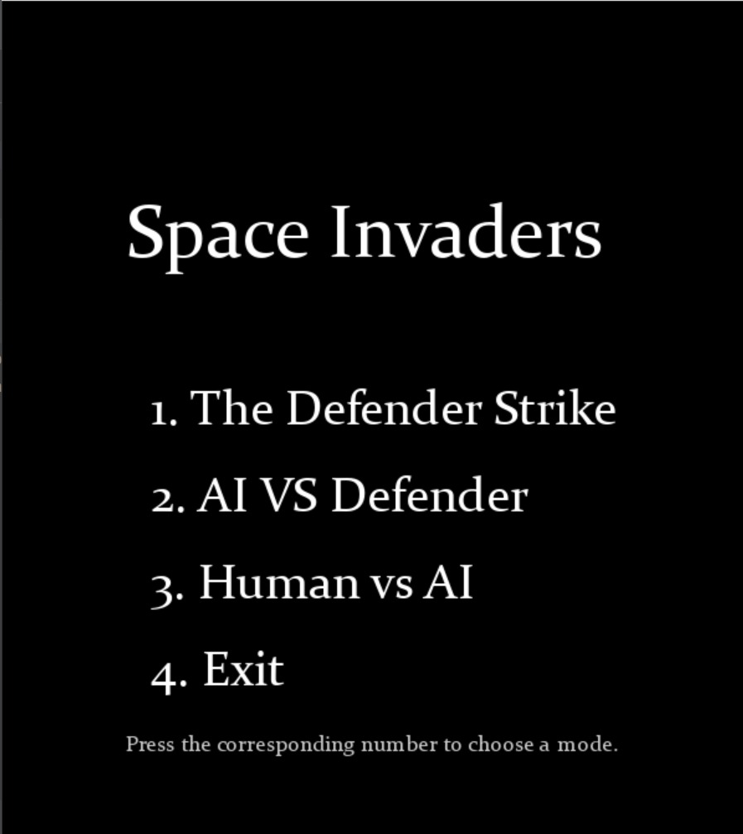



Unique Features of This Space Invaders Project
This project brings fresh ideas to a classic game.
Multi-Agent
AI Learning
Enables diverse scenarios and comparative analysis of human and AI.
AI agents adapt and improve their strategies over time.
Human-AI Collaboration
Explores the potential of synergistic gameplay, with human and AI agents.

Slide 4




Unique Value Proposition
Why is this project different?
Focus on Human vs AI
A deeper dive into the relative performance of each.
Three Different Game Modes
A richer environment for performance analysis.
Synergistic Gameplay
Innovative features for better results.

Slide 5
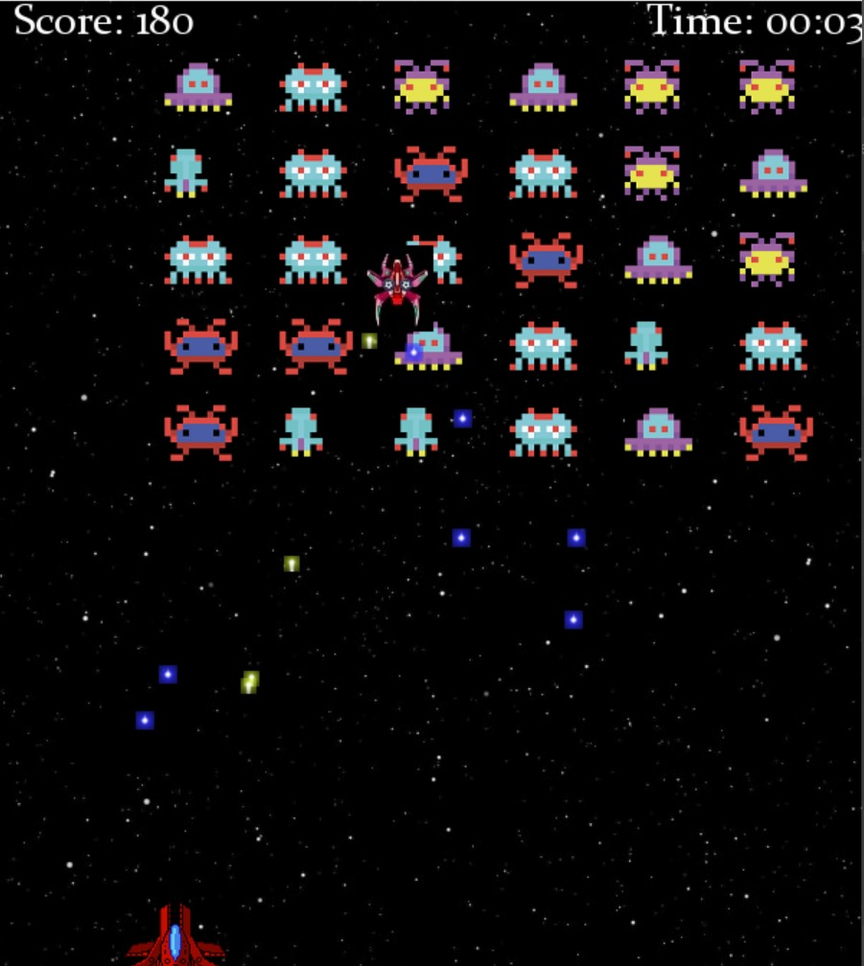
Differentiating from Other Space Invaders Games
This project introduces the complexity of multi-agent systems to a simple game.
AI Learning Capabilities
Multiple Game Modes
Evaluates performance across varied conditions.
AI agents adapt and improve through reinforcement learning and predictive movement algorithms.
Human-AI Interaction
Explores team dynamics.

Slide 6
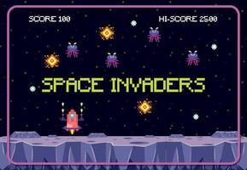



Human Agent Interface and Data Collection
The user interface is designed for intuitive control and comprehensive data tracking.
User-Friendly Interface
Data Logging
Anonymization
Performance Metrics

Slide 7
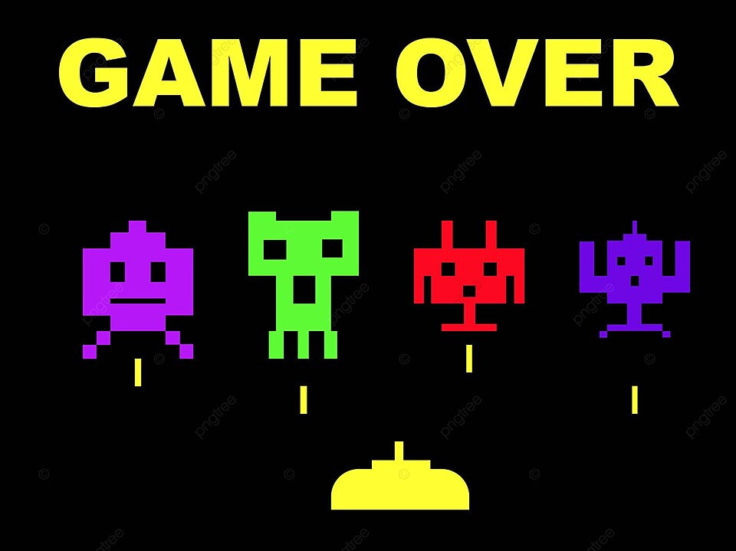
Conclusion: Implications and Future Directions
This project provides valuable insight into AI capabilities.
1
AI shows potential to surpass human performance.
2
Human players have unique strategic decision-making skills.
3
Collaboration offers promising avenues.
4
Future research can explore more complex AI and communication.

Slide 8


